Slide 1

Architectural Metadata for Memory Safety
Dr. Nathaniel “nwf” Filardo
2024 Dec 4

Slide 2
Who am I?
Former CMU physics then CS undergrad, 410 student & TA, 213 instructor, ...
  You can blame me for swexn()
Contractor for SCI Semi, previously postdoc at Cambridge and researcher at Microsoft
  I am not speaking on behalf of any employers. Opinions herein are mine.
  None of this should be taken to be information about product plans.
I prefer talks with interrupts enabled; please ask questions as they arise

Slide 3
Outline
Software security (or: “how are buffer overflows still a thing?”)
Pointer authentication (ARMv8.3, ~2017)
Pointer coloring (ARMv9 MTE, ~2023)
  Newly on market: Google Pixel 8 (“Tensor G3” CPU), October 2023
Upgrading pointers (CHERI; commercial availability in 6 months to ~5 years)
Safe languages on safe architectures
Notes:
This is, broadly, a talk about software security, especially “memory safety”.
After a quick review, we’ll focus on a defensive technology that shipped to end users this year, what we might call “pointer coloring”.
After that, we’ll look at a long-running research project to abolish pointers that looks like it might escape the lab and ship within the next five years.
And last, we’ll talk about how all of this silicon-level stuff still matters even if we have safe programming languages.

Slide 4
Learning Goals
Memory safety (esp. spatial, temporal)
Metadata in pointers: authentication & coloring
Memory capability
Notes:
The big things I want you to take away from this talk are
the notions of “spatial” and “temporal” memory safety (I did say I was a physicist once, right?)
the idea of sticking metadata in pointers, especially pointer coloring
the use of memory capabilities to replace addresses

Slide 5

Modern Computer Architecture:
Unsafe at Any Speed?
Ralph Nader. Unsafe at Any Speed. (1965)
Kamp. Linear Address Spaces: Unsafe at Any Speed. (2022)
Notes:
A more inflammatory title for this talk.
Why might someone claim this?

Slide 6
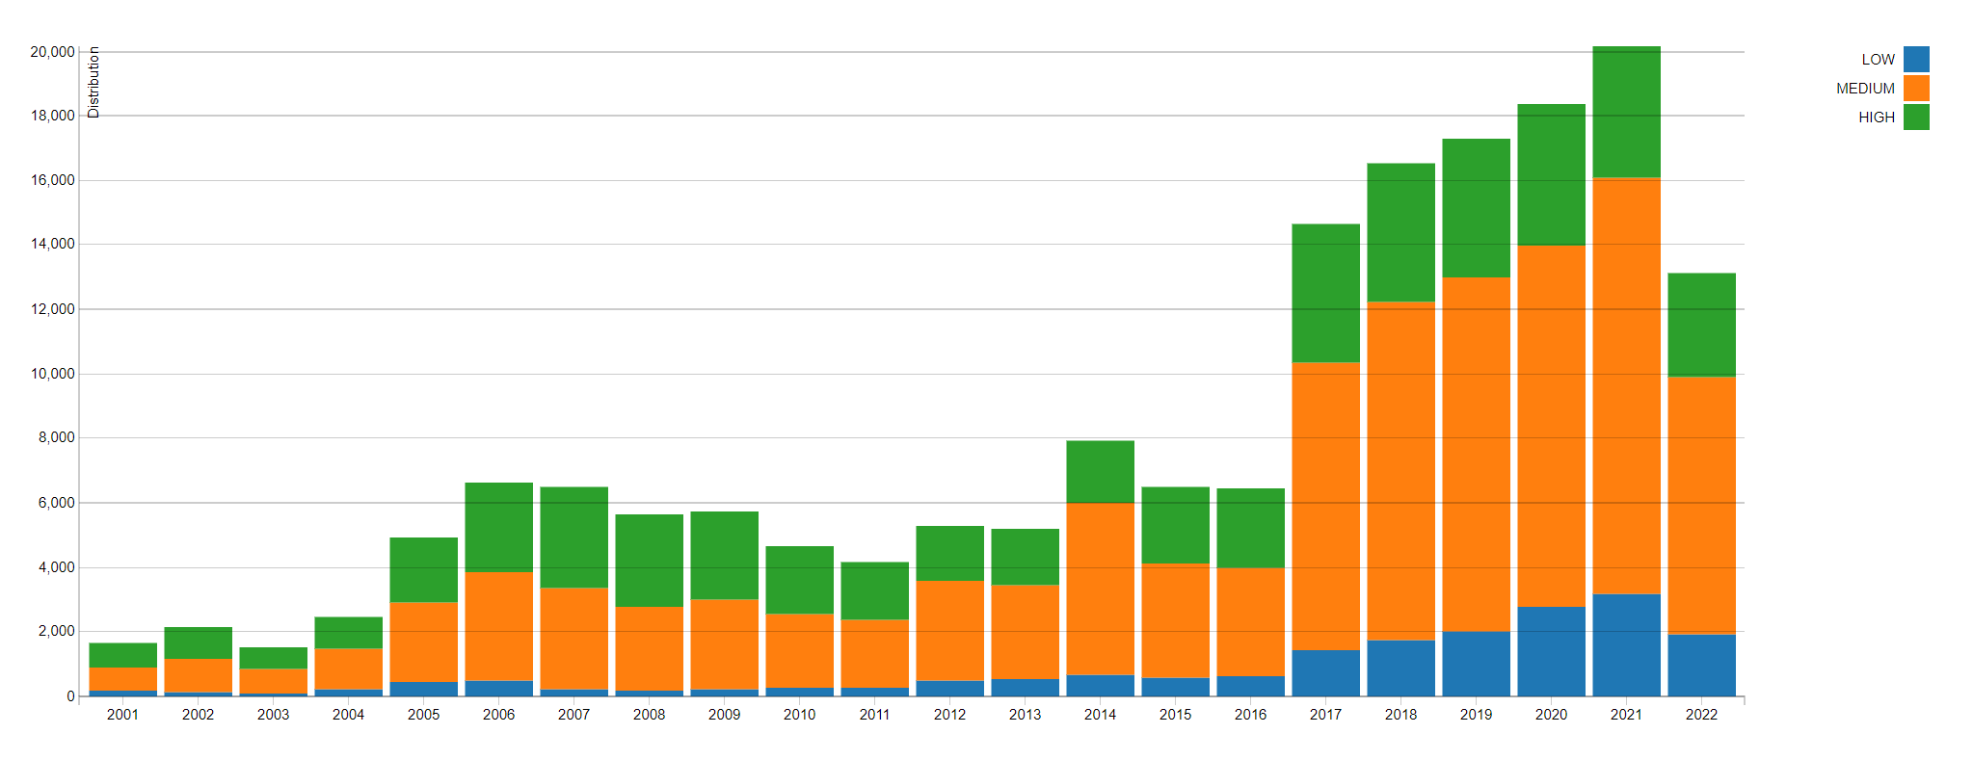
CVEs and High Severity Bugs from (Lack of) Memory Safety
CVSS Severity Count Over Time (as of 22 Jul 2022)
NVD - CVSS Severity Distribution Over Time (nist.gov)
Notes:
A less contentious phrasing is that software security isn’t great. As computers continue to infiltrate every aspect of existence, we are seeing a steep upwards trend in yearly CVEs…
(And no, 2022 wasn’t a great year, they just stopped counting half-way through. The graph hasn’t updated since.)

Slide 7
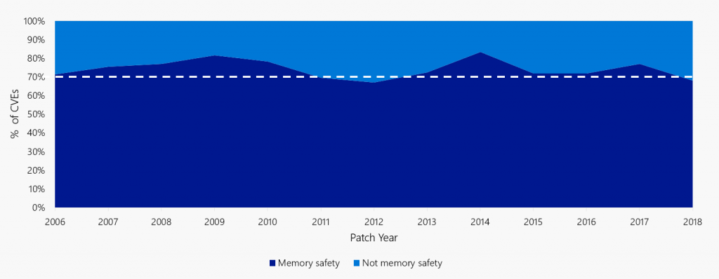
CVEs and High Severity Bugs from (Lack of) Memory Safety
Matt Miller. Trends, challenge, and shifts in software vulnerability mitigation. (BlueHatIL 2019)
Notes:
But, embarrassingly, these tend not to be new kinds of bugs in new kinds of domains. Rather, year after year, 70% of these turn out to be from memory safety problems: pointer injection, buffer overflows, use-after-free, and so on. The kinds of things you learned about in 213. These problems have been with us “since the beginning”, at least of UNIX; so, 50 years, if not even longer; came to broader awareness in 1996 with “Smashing the Stack for Fun and Profit” by Aleph One, and even by that standard it’s been 25 years and counting.

Slide 8

Modern Architecture Unsafety
Very Short, Not At All Comprehensive, Examples
Notes:
Let’s have a look at what we’re up against, in the shape of small examples

Slide 9
Misbehaving C Program: Spatial & Referential Safety Violations
foo:
mov w8, #65
strb w8, [x0, #16]
strb w8, [x0, #32]
ret
main:
sub sp, sp, #48
stp x29, x30, [sp, #32]
add x29, sp, #32
mov x0, sp
bl foo
ldp x29, x30, [sp, #32]
mov w0, wzr
add sp, sp, #48
ret // x30
Stores relative to address in x0
void foo(char *buf) {
buf[16] = 'A';
buf[32] = 'A';
}
int main(void) {
char pad[16], buf[16];
foo(buf);
return 0;
}
AArch64
x0 holds address of buf on stack
Stack as of entry to foo()
sp+32 | main’s RA & FP
sp+16 | pad[0] … [15]
sp+0 | buf[0] … [15]
Several things go wrong:
Write outside of allocation (lack of spatial safety)
​Corrupt saved return address (lack of integrity)
Jump to corrupted address when main() “returns” (lack of referential safety)
a0 = &buf[0]
Notes:
Let’s look at some memory safety problems. Here’s a very basic C program with stack allocations, a function call, and at least two rather glaring problems.
Here’s one possible compilation of our program into AArch64.
We can work out what the stack might look like when we make that function call, and there’s nothing really surprising here. Reading upwards, we have our two buffers, buf then pad, and then the saved return address.
Gazing further into the assembler, we see that the stores done in foo() are performed relative to the register x0…
And, looking a little further down, we see that the compiler has inserted code to copy the stack pointer, which, we said, had buf at its lowest address, into the register x0. So that’s all as expected.
What happens when this program runs? Several things go wrong in escalating, rapid succession.
First, we write outside the intended allocation and into another object. That’s bad, but it’s at least something we can kind of explain using names of things visible in the language. This is a violation of spatial safety, because we're violating the spatial extent of an object.
Then we write outside the language-visible allocations into something that’s deeply magic – the compiler/ABI-inserted, anonymous return address. That’s worse! We can think of this as a loss of integrity, having damaged a meaningful structure.
Then, when main goes to return, a while after our bug, it jumps off into the weeds to a corrupted address. This is a lack of referential safety, since we now jump to something that wasn't a return address to which we meant to jump.

Slide 10
Temporal Safety
Memory is there to be (re)used
  C language and compiler reuses stack memory aggressively by design
  Heap allocator reuses freed objects for new ones
What about use-after-free?
char *p = malloc(1024); // say: p == 0x15410DE0U
free(p);
char *q = malloc(1024); // quite likely: q == 0x15410DE0U
strcpy(p, “oh no”); // p == q, but different objects!
Notes:
Referential and spatial safety aren’t the only things we have to worry about.
Temporal safety ensures that we attempt to access objects only within their lifetimes.

Slide 11
Architecture Enables Safety Violations
Allocation
64-bit
pointer
Address (64 bits)
Architecture insufficiently informed:
Nobody told the CPU about the buf object (its extent, lifetime, type, &c)
When code wrote out of bounds, the store silently corrupted memory
That memory was holding a pointer, but CPU just thinks “bytes”
Deallocation and reuse of memory not communicated to CPU
C pointers compiled to machine words, stored as bytes in memory.
Virtual
address
space
Notes:
Let’s spend a moment being sort of philosophical about what just happened.
I’d contend that each thing stems from the CPU not knowing enough about what’s going on.
Nothing foo() had to hand (in registers) told it how big the buffer it was storing into was, just “here’s an address, go for it”
The out-of-bounds write silently corrupted a pointer main() cared about.
When main() does jump to its popped return address, the CPU didn’t notice the corruption, because any sequence of bytes might be a pointer and so: off we go.
Temporal safety: “object” and “lifetime” are not things the architecture understands
Note the common cause: we compiled a pointer, a semantic object, into just its runtime address, and there’s nothing special about addresses: they’re just fixed-width numbers stored as bytes in memory.

Slide 12
OK, But That’s Just C!
Rewrite the world in a safe language!
  LISP, Scheme, Rust, Java, JavaScript, ML, Ur/Web, Haskell…
  Different data representations, operational semantics, static type systems…
Safe?
    Array index errors throw exceptions; other spatial errors impossible*
    Temporal errors impossible*
    * Some assumptions apply; see next slide
Notes:
Very nearly all C is compiled like that; maybe it’s C’s fault and we should rewrite the world in something (anything) else.
Candidate languages all bring different things to the table, but notably they all tend to have data representations and runtime systems that (claim to) rule out the kinds of problems we’re considering.

Slide 13
What About All The Stuff We Can’t Rewrite?
A staggeringly large amount of software already exists.
  OpenHub.net estimates ~10B LoC of C, ~3B LoC of C++ just in the open world.
    That probably works out to $130G - $1.3T to rewrite everything.
A lot of effort in optimizing that software! FFI bridges for the stuff we like?
    Hand-tuned, specialized implementations... like xz!
    Correctness can be subverted by foreign code!
Language correctness often depends on (huge) runtime systems!
  Written in C (or something like it)!
    By humans!
Notes:
There are, however, two small problems with that proposal:
There’s a lot of C/C++ out there, some of which we might even want to keep using (like optimized libraries).
We could introduce FFI bridges for such things, but now we’ve shot a hole through our runtime system and its defenses.
The runtimes for these languages can be enormous! They’re very often some of the trickiest parts (e.g., garbage collector) and are written in C, and by humans, at that!
Maybe C needs saving.

Slide 14
What Have We Tried Doing?
Lots of people have tried lots of things:
  Software tricks: stack canaries, guard pages, ASLR, W^X, fat pointers, …
  Static analyses: symbolic execution, fuzzing, …
  Languages: Ada, ML, Haskell, Java, JavaScript, C#/.Net, Rust, …
  Computers: System/36, iAPX 432/BiiN, …
  Architectural edits: BTI, continual excavation below ring 0, …
Notes:
Lots of people have tried lots of things ranging from minor tinkering to vast, sweeping overhauls of everything.

Slide 15
What Now?
Increasingly popular “new old thing” is to add metadata to existing architecture:
Arm “Pointer Authentication Code” (PAC) integrity checks (commercialized ~2017)
  Make it harder to “forge” pointers / easier to detect forgeries
Arm “Memory Tagging Extension” (MTE) “lock and key” covariance (~2023)
  Make it harder to access memory out of bounds or after free
CHERI memory capability system (2025?)
  Deterministic memory safety and software compartmentalization
Notes:
Today we’re going to focus on one kind of thing, adding and tracking “metadata” as part of the computation. We’re going to look at two existing and one new technologies.

Slide 16

Arm’s Pointer Authentication
Embedding Cryptographic Signatures

Slide 17
Recall: Architecture Enables Safety Violations
Ret Addr
Allocation
64-bit
pointer
Address (64 bits)
Traditional stack allocation buffer overflows targeted the return address
  (Historically, point into on-stack shell code; now, “Return Oriented Programming” chain)
Can we authenticate the real return address & make forgeries crash?
Virtual
address
space
Notes:
If we're worried about pointer corruption – and we should be, it's a popular exploit primitive – can we do something to make it harder to undetectably corrupt a pointer?

Slide 18
Architecture Enables Safety Violations
Allocation
64-bit
pointer
Address (64 bits)
Architecture insufficiently informed:
Nobody told the CPU about the buf object (its extent, lifetime, type, &c)
When code wrote out of bounds, the store silently corrupted memory
That memory was holding a pointer, but CPU just thinks “bytes”
Deallocation and reuse of memory not communicated to CPU
C pointers compiled to machine words, stored as bytes in memory.
Virtual
address
space
Notes:
Phrased differently, what if we imposed some clever consistency checks on bytes in memory?

Slide 19
PAC-ing Extra Bits
Ret Addr
Allocation
64-bit Signed
pointer
PAC (≈24 bits)
Address (≈40 bits)
Can we authenticate the real return address & make forgeries crash?
Carve out something sizable, like 24 bits, for signature bits, at the top of pointers
  Systems generally required sign-extension anyway! ("canonical address")
Add instructions to compute and verify PAC.
  Attempting to use a PAC-signed pointer directly will trap; bits not sign extension!
  Verification failure writes “error code” to PAC bits; will also trap if used.
Virtual
address
space
Arm - Understand Arm Pointer Authentication
Qualcomm - Pointer Authentication on ARMv8.3
Notes:
One way to do this would be to divide the 64 bits of the pointer, many of which are unused in practice, into an address and a “pointer authentication code”.
One plausible division is 40 bits of address and 24 bits of PAC.
We’ll add some instructions that sign a canonical pointer by replacing the top bits with the PAC and some that verify a PAC’d pointer and either write back a canonical value or an error value.

Slide 20
What to PAC?
Cryptographically combine:
  The pointer’s value
  A secret value (from a kernel-managed control register)
  A “context” word (TBD)
Cryptography? Secrets?
  Make it hard to “forge” pointers, even if some have leaked
  More than one secret: sw sign for different purposes (stack pointer, function pointer, data pointer, …)
Context?
  Further differentiation of authentication tag, without requiring more and more secrets
  “Not just any return address, the one right here on the stack.”
  “Not just any pointer, but one that points to type 0x15410DE0U”

Slide 21
Spilled Return Address: Without PAC
foo:
mov w8, #65
strb w8, [x0, #16]
strb w8, [x0, #32]
ret
main:
sub sp, sp, #48
stp x29, x30, [sp, #32]
add x29, sp, #32
mov x0, sp
bl foo
ldp x29, x30, [sp, #32]
mov w0, wzr
add sp, sp, #48
ret // x30
void foo(char *buf) {
buf[16] = 'A';
buf[32] = 'A';
}
int main(void) {
char pad[16], buf[16];
foo(buf);
return 0;
}
AArch64
Spill and restore “link register” x30
Canonical Pointer
Stack as of entry to foo()
sp+32 | main’s saved RA
sp+16 | pad[0] … [15]
sp+0 | buf[0] … [15]
0x0000_0000_0010_CAFE
a0 = &buf[0]
Notes:
So with that new metadata in mind, here’s what things looked like before…
By contrast to X86, where calls push the return address to the stack, on ARM (and, indeed, most RISC architectures), the return address is instead stored to a register, called the “link register”. On AArch64, that’s “x30”. If a function makes a call, it must spill and restore the link register, which we can see main doing here with a “store pair” and later “load pair” instruction (along with x29, the frame pointer, like x86's %ebp).

Slide 22
Spilled Return Address: With PAC
foo:
mov w8, #65
strb w8, [x0, #16]
strb w8, [x0, #32]
ret
main:
pacia x30, sp
sub sp, sp, #48
stp x29, x30, [sp, #32]
add x29, sp, #32
mov x0, sp
bl foo
ldp x29, x30, [sp, #32]
mov w0, wzr
add sp, sp, #48
autia x30, sp
ret // x30
void foo(char *buf) {
buf[16] = 'A';
buf[32] = 'A';
}
int main(void) {
char pad[16], buf[16];
foo(buf);
return 0;
}
Sign link register w/ stack pointer
AArch64
Spill and restore “link register” x30
PAC’d Pointer
Canonical Pointer
Verify signature on link register
Stack as of entry to foo()
sp+32 | main’s PAC’d RA
sp+16 | pad[0] … [15]
sp+0 | buf[0] … [15]
0xE7A3_F000_0010_CAFE
0x0000_0000_0010_CAFE
autia sets x30 to (say) 0xDEAD_0000_0010_CAFE.
ret faults on noncanonical value; hooray!
a0 = &buf[0]
Notes:
To detect corruption of the spilled return address, we can guard it with PAC. We’ll sign the link register’s value with one of the secrets and store that to the stack instead. When we restore it, before jumping, we’ll ask PAC to validate the loaded value.

Slide 23
PAC Deployment
PAC “needs to get everywhere”: potentially every creation and use of a pointer! How?
Staged deployment strategy:
Recompile binaries with a subset of pointer signing
  Instructions are cleverly encoded as “no-op hints” on old machines
Make kernel changes to turn on feature for binaries requesting it
  Recompiled binaries get more secure
For new software targeting new CPUs, can use more pointer signing features
  Easier for some (Apple, Android) than others (Microsoft, mainstream Linux, *BSD)

Slide 24
PAC Summary
Increasingly deployed in practice, especially in Apple’s ecosystem
Easy to take first steps
Generally effective in its niche
Bypasses do still happen:
  If attacker can repeatedly try a guess at a forged pointer, 2²⁴ is not a lot of guesses.
  If attacker has cross-context access to a “signing gadget”, may not need to guess
Google Project Zero - Examining Pointer Authentication on the iPhone XS (2019)

Slide 25

Arm’s Memory Tagging Extension
Coloring Pointers and Memory

Slide 26
Architecture Enables Safety Violations
Allocation
64-bit
pointer
Address (64 bits)
Architecture insufficiently informed:
Nobody told the CPU about the buf object (its extent, lifetime, type, &c)
When code wrote out of bounds, the store silently corrupted memory
That memory was holding a pointer, but CPU just thinks “bytes” PAC checked!
Deallocation and reuse of memory not communicated to CPU
C pointers compiled to machine words, stored as bytes in memory.
Virtual
address
space
Notes:
But hey, there are other aspects intent we haven't tried communicating to the architecture... PAC got us something about pointer integrity, but didn't really address the whole "we can write out of bounds??" thing in the first place!

Slide 27
MTE Architecture
Allocation
64-bit MTE
pointer
Tag
Address (60 bits*)
Carve out 4 bits from each 64-bit pointer for a tag (or “color”)
Bolt 4 bits next to each 16 bytes of physical memory
  (Wait, how?? Buy special memory? Is there a clever trick?)
Add instructions to change tag in pointer or next to memory
Require that these match on load/store operations (or else ~SIGSEGV?)
Virtual
address
space
Arm - Delivering enhanced security through Memory Tagging Extension (2021)
Arm MTE whitepaper
Notes:
Tagged memory (and pointers). Shocking, given the name.
Concretely, MTE steals four bits from each pointer for a “color” tag and bolts a 4-bit color to each 16 bytes of memory.
It adds instructions to manipulate these tags and imposes a requirement on loads and stores that the tags match.

Slide 28
MTE for Spatial Safety
Software (heap, compiler) can ensure that adjacent objects never the same color:
Easy in malloc; some subtlety in stack handling; globals (.data) a little tricky
Further displacements caught 15/16 times*
Adjacent overflow and underflow caught

Slide 29
MTE for Temporal Safety
Heap temporal safety: freed and (re)allocated objects’ colors changed
  Easiest to pick allocated object color (not neighbors!) at random; will most likely be a different color.
  Might reserve one color for free objects & always exclude previous color
UAF caught
UAR caught
(definitely, then 14/15)
Eventually, we’ll run out of colors (pigeon-hole principle) and somewhere we’ll have a collision
(UAR not caught):
Neighbors could also collide colors: wouldn’t detect simultaneous UAF & OOB access:

Slide 30
Misbehaving C Program: Spatial & Referential Safety Violations
foo:
mov w8, #65
strb w8, [x0, #16]
strb w8, [x0, #32]
ret
main:
sub sp, sp, #48
stp x29, x30, [sp, #32]
add x29, sp, #32
mov x0, sp
bl foo
ldp x29, x30, [sp, #32]
mov w0, wzr
add sp, sp, #48
ret // x30
Stores relative to address in x0
void foo(char *buf) {
buf[16] = 'A';
buf[32] = 'A';
}
int main(void) {
char pad[16], buf[16];
foo(buf);
return 0;
}
AArch64
x0 holds address of buf on stack
Stack as of entry to foo()
sp+32 | main’s saved RA
sp+16 | pad[0] … [15]
sp+0 | buf[0] … [15]
a0 = &buf[0]
Notes:
So with that new metadata in mind, here’s what things looked like before…

Slide 31
Misbehaving C Program: Spatial Safety Violations, with Slideware MTE
foo:
mov w8, #65
strb w8, [x0, #16]
strb w8, [x0, #32]
ret
main:
sub sp, sp, #48
stp x29, x30, [sp, #32]
add x29, sp, #32
irg x0, sp
stg x0, [x0]
bl foo
stg sp, [sp]
ldp x29, x30, [sp, #32]
mov w0, wzr
add sp, sp, #48
ret // x30
Stores unchanged
void foo(char *buf) {
buf[16] = 'A';
buf[32] = 'A';
}
int main(void) {
char pad[16], buf[16];
foo(buf);
return 0;
}
AArch64 + MTE
Copy sp to x0, insert random tag
Set tag in memory
Put “sp” tag back
Stack as of entry to foo() |  | Tag
sp+32 | main’s saved RA | 1
sp+16 | pad[0] … [15] | 1
sp+0 | buf[0] … [15] | 7
Mismatch reported here:
Tag in x0 != tag at [x0, #16]
x0 = &buf[0], tag 7
Notes:
What does all that mean in practice? Let’s look at our example program again, this time compiled with MTE.

Slide 32
MTE Enforcement
MTE has three enforcement strategies, trading security for performance:
Synchronous: each load and store will check tags before committing, will trap (SIGSEGV) on mismatch.
Symmetric asynchronous: loads or stores commit regardless of tags, mismatches set a flag
  Kernel expected to check flag and kill process on each entry (syscall, trap, or interrupt).
Asymmetric asynchronous: loads synchronous, stores asynchronous.
  Synchronous loads “easy” to do fast: data coming from cache/RAM anyway.
  Synchronous stores slow: performance needs stores to complete without loading cache line.
Intended deployment scenarios look like “accelerated debugging”:
At scale, in production:
  an async mode to answer, “is there a bug?”;
  once “yes”, switch to sync
Under fuzzing, in sync mode.

Slide 33
MTE Weaknesses
Kernel access to user memory is generally not (at present) mediated by MTE.
Probabilistic arguments (“15/16”) fall if the attacker can forge tagged pointers of the right color.
Opinions vary, but: MTE is not generally considered viable defense against determined attackers.
Notes:
MTE does have some weaknesses, as a defensive technology:
As deployed now and for the foreseeable future, the kernel ignores MTE when accessing user memory.
MTE’s security relies on an attacker not being able to forge pointers with the correct colors. If attackers can forge pointers, then probabilistic arguments like “15/16 times, this is detected” fail.
Reasonable people can have nuanced opinions, but in general, MTE is not presumed to be able to limit the damage of a determined attacker against individual systems. It really is intended for debugging-at-scale.

Slide 34
MTE Summary
In shipping arm cores!
At-scale audit & debug
High probability of finding bugs
High cost of synchronous mode
Weak against directed attacks

Slide 35
Architecture Enables Safety Violations
Allocation
64-bit
pointer
Address (64 bits)
Architecture insufficiently informed:
Nobody told the CPU about the buf object (its extent, lifetime, type, &c) MTE color extent!
When code wrote out of bounds, the store silently corrupted memory
That memory was holding a pointer, but CPU just thinks “bytes” PAC checked!
Deallocation and reuse of memory not communicated to CPU MTE recolored!
Things are decidedly looking better…
Virtual
address
space

Slide 36
Probabilistic Defenses Should Be A Last Resort
PAC and MTE both fail if the adversary “knows” the right secrets to forge a pointer
This is not an idle threat:
  MTE weakens PAC in combination: 20-bit PAC + 4-bit color
  Information disclosure vulnerabilities
  Speculative side channels
  Maybe use forging gadgets (PAC signing code, MTE memory or pointer recoloring code)
  Might have repeated ability to guess (1M guesses is not a lot)
  Sometimes we call the adversary (“library dependency”, “foreign code”, “plugin”, “JIT-ed code”)
PAC and MTE show willingness to increase security by…
  getting new computers (adding metadata and new instructions to the architecture),
  changing system software, and
  recompiling.
If we’re willing to do all that, can we do better than probabilistic defenses?

Slide 37

CHERI Memory Capabilities
Architecture Overview
Chisnall et al. Beyond the PDP-11: Architectural support for a memory-safe C abstract machine. (ASPLOS 2015)
Notes:
A different approach, and one that I’ve worked on for a few years now, is CHERI.

Slide 38

Architecture Enables Safety Violations
Allocation
64-bit
pointer
Address (64 bits)
Architecture insufficiently informed:
Nobody told the CPU about the buf object (its extent, lifetime, type, &c)
When code wrote out of bounds, the store silently corrupted memory
That memory was holding a pointer, but CPU just thinks “bytes”
Deallocation and reuse of memory not communicated to CPU
C pointers compiled to machine words, stored as bytes in memory.
Virtual
address
space
Notes:
Let's try for something that touches all of the points, too! Something that captures and enforces spatial bounds, something that recognizes that pointers are special, and something that might serve as a substrate for temporal safety?

Slide 39
Spatially-Safe C/C++ with Memory Capabilities
Valid bit
Allocation
Abstract Capability
Upper bound (64 bits)
Address (64 bits)
Lower bound (64 bits)
New datatype for use instead of integer pointers
Still need the address (virtual or physical)
Add bounds, checked on every load/store
Add validity tag attesting well-formedness of capability
struct {
uint64_t address;
uint64_t bound_lower;
uint64_t bound_upper;
bool valid : 1; // kinda
} abstract_capability;
Virtual
address
space
Henry M. Levy. Capability-Based Computer Systems (1984)
Notes:
Let’s replace pointers with capabilities to regions of memory. Such a capability still needs to carry the address it’s pointing to.
But we also need to carry bounds around with us; that’s one…
… and two more addresses: a lower base and an upper limit.
As we saw with the return address, we want to distinguish between valid pointers and those that have been fabricated or tampered with somehow (including by having some bytes overwritten).
This must be special, somehow, so we’ll set it apart from the bytes that make up our better pointer.

Slide 40
Operations on Capabilities
What do we want the architecture to support?
Valid bit
Allocation
Abstract Capability
Upper bound (64 bits)
Address (64 bits)
Lower bound (64 bits)
Address arithmetic instructions, w/o changing bounds:
  CIncOffset – add signed integer displacement to address
  CGetAddr, CSetAddr – extract or inject integer address field
Bounds can be narrowed but not broadened:
  CSetBounds – valid result only if new bounds are within original bounds
Validity tracking: capability valid only if it comes from another pointer via approved transforms
Virtual
address
space
CHERI Instruction-Set Architecture (Version 9)
Notes:
Let’s think about what we do (and don’t do) with pointers:
One thing we’d better be able to do is manipulate the address just like we could when we were just using addresses without this machinery.
There’s special handling for offsetting (signed addition), and for everything else there’s a getter and a setter, so you can pull out the address, do whatever you need, and put it back.
If we want bounds to save us from ourselves, we need to be able to construct a narrower pointer from a wider one. This had better be a monotone non-increasing operation, so can’t widen bounds!
(CSetBounds uses current address as new lower bound, takes length to compute new upper bound)
And last, we can do anything else we like with the bytes of a capability, with the understanding that the architecture will invalidate it (clear its valid bit).
If the valid bit is set, we know that only approved operations have been performed to get to this point. This is a kind of “compressed provenance tracking”: a set valid bit implies that this capability has come about exclusively through valid operations.

Slide 41
CHERI: Memory Capabilities (For Real This Time)
Abstract datatypes are all well and good, but we’re building systems here!
Valid bit
129-bit CHERI Capability
Allocation
Metadata, compressed bounds (64 bits!)
Address (64 bits)
struct {
int address : 64;
int top_mantissa_exp : 12;
int bottom_mantissa_exp : 14;
int bounds_denormalized : 1;
int permissions : 16;
int flags : 1;
int seal : 18;
bool valid : 1; // out of band!
} CHERI_mem_cap;
CHERI defines architectural representation of capabilities
  2x integer pointer size (+1 bit) via bounds compression
CPU instructions manipulate compressed form
Every load and store instruction executed must be
to an address in bounds of a valid capability!
  Or else the CPU traps: capability fault, like page fault
Add permissions and other metadata too
Virtual
address
space
CHERI Instruction-Set Architecture (Version 9)
Notes:
OK, while that’s a nice abstraction, we’re trying to build systems here, so what would it look like, much more concretely? Besides, three 64-bit words is just a joke, right?
CHERI defines an architectural representation for capabilities. The fat pointer bits are twice the size of an integer pointer, or 128 bits, but there’s still that “+1” on the side.
These are understood by the CPU hardware. Like x86’s progression (ax, eax, rax), registers are extended to hold capabilities. Act like 64 or 129-bit registers as appropriate.
Every load and store instruction checks that the address is within bounds of a valid capability.
If that isn’t true, the CPU will trap, raising a capability fault, rather like a page fault.
There are, concretely, permission bits as well as other metadata bits within the fat-pointer region, as well.
We can get into that more in Q&A if people want.

Slide 42
Capabilities in Registers and Memory
Physical Memory in Capability-sized pieces
Register
Cap valid?
Cap valid?
load.cap $2, 0($4)
store.byte $1, 0($4)
$1
Data
Data
0
Data
0
load.cap $3, 0($4)
load.word $1, 0($3)
$2
Data
0
Data
0
Trap! $3 is not valid!
$3
Capability
1
Capability
1
$4
Capability
1
Capability
1
Data
Data
Capability
Capability
0
1
1
0
Capability
1
Program counter register also holds a capability!
CHERI embodies a very simple (1-bit) “dynamic type” system:
  Every word is either a capability or just an integer
  Trap if integer used where a capability is required
Notes:
Let’s look at making a very small CHERI computer. We’ll start with some registers…
Each register can hold a capability and will track its valid bit.
For every Capability-sized granule (sized and aligned region) of physical memory…
… we’ll also add a valid bit.
Let’s initialize our machine so that $4 points to some word of memory and $1 is holding some data.
Here are some (capability-authorized) load and store instructions, of capabilities and data.
Let’s run them and see what happens.
When we load a capability using another one, the tag comes along for the ride. Here, that tag was set in memory, and so the tag of $2 is set.
If we store the data component of a register to memory, it always clears the target’s tag.
Now we try to load a capability and instead get data, so the tag in the target register, $3, is now clear.
If we try to access memory using an untagged register, the machine traps (like if we’d tried to read out of bounds)!
In addition to the general-purpose registers, the program counter register is also a capability.
In all, then, CHERI adds a 1-bit “dynamic type” / “tagging” system to the architecture: every word is either a capability or it isn’t. Memory access requires a capability.
(Slide credit to Dr. David Chisnall; all errors introduced by nwf)

Slide 43
Misbehaving C Program: Spatial & Referential Safety Violations
foo:
mov w8, #65
strb w8, [x0, #16]
strb w8, [x0, #32]
ret
main:
sub sp, sp, #48
stp x29, x30, [sp, #32]
add x29, sp, #32
mov x0, sp
bl foo
ldp x29, x30, [sp, #32]
mov w0, wzr
add sp, sp, #48
ret // x30
Stores relative to address in x0
void foo(char *buf) {
buf[16] = 'A';
buf[32] = 'A';
}
int main(void) {
char pad[16], buf[16];
foo(buf);
return 0;
}
AArch64
x0 holds address of buf on stack
Stack as of entry to foo()
sp+32 | main’s saved RA
sp+16 | pad[0] … [15]
sp+0 | buf[0] … [15]
a0 = &buf[0]
Notes:
So, with CHERI in mind, here’s what things looked like before…

Slide 44
Misbehaving C Program: Spatial & Referential Safety Violations
foo:
mov w8, #65
strb w8, [c0, #16]
strb w8, [c0, #32]
ret
main:
sub csp, csp, #64
stp c29, c30, [csp, #32]
add c29, csp, #32
scbnds c0, csp, #16
bl foo
ldp x29, x30, [sp, #32]
mov w0, wzr
add sp, sp, #48
ret // c30
Stores relative to capability in c0
void foo(char *buf) {
buf[16] = 'A';
buf[32] = 'A';
}
int main(void) {
char pad[16], buf[16];
foo(buf);
return 0;
}
Morello
x0 holds cap to buf on stack
Stack as of entry to foo() |  | V
sp+32 | main’s saved RA | 1
sp+16 | pad[0] … [15] | 0
sp+0 | buf[0] … [15] | 0
gdb says:
Program received signal SIGPROT, CHERI protection violation
Capability bounds fault
… in foo (buf=0x3fffdfff70 [rwRW,0x3fffdfff70-0x3fffdfff80] …)
ca0
CHERI C/C++ Programming Guide (2020)
Notes:
And now, if we compile to Morello… the program looks pretty similar.
The first thing to note is that our “store byte” instructions have become “capability-authorized store byte” instructions, citing the capability register c0 (the augmented x0 register).
The second thing to see is that the callsite of foo has not simply copied the stack capability from csp into the argument register c0, as it did the stack pointer before, but it now builds a capability with narrower bounds to pass as the argument.
(The 16 here is an immediate, since we statically know the desired size. There is also a form that takes the length from a register.)
This program crashes when run, in foo: 16 up from c0 is out of bounds.

Slide 45
Secret-Free, Deterministic Mechanism
CHERI is secret-free and deterministic, in contrast to PAC and MTE.
An adversary cannot forge a capability even if they know every bit of system state.
  No MTE colors, PAC secrets, ASLR slide, …
  Can’t re-inject data as pointers: no more Smashing The Stack For Fun And Profit even ignoring bounds
  Speculative execution not a threat to protection mechanism
Out-of-bounds or invalid dereference always traps.
Byte-level corruption or attempts to widen bounds always caught (clear tag or trap).
Amar et al. An Armful of CHERIs. (2022)
Notes:
We should emphasize that CHERI is secret-free and completely deterministic.
A would-be attacker cannot forge a capability, like they could forge addresses, even if they know every bit of the system state. It’s not that you can’t leak addresses anymore, it’s that knowing the address probably doesn’t do you much good. Even if we ignore bounds, you can’t ship a tagged capability across the network.
A CHERI system will always trap if the program tries to dereference out of bounds or through an invalid capability.
Byte-level corruption or attempting to widen bounds will always be caught and inhibited, either by clearing the tag of the result or by raising a trap.

Slide 46
CheriABI: Spatially Safe *NIX Processes
Significant ambient authority in modern *nix-like systems: system calls!
Code might mislead kernel into violating spatial safety (“confused deputy”). Consider:
  char buf[1024];
  read(fd, buf, 2048);
CheriABI makes system calls take and return capabilities instead of integer addresses!
  Kernel uses passed-in capabilities to limit its own behavior.
  read(fd, buf, len) won’t write beyond buf’s capability bounds, even if len says to!
  Passes the user’s buf to BSD’s centralized copyout() facility.
    Facility exists to deal with page faults.
    Easily extended for CHERI faults; no new bounds-check instructions!
Davis et al. CheriABI: Enforcing Valid Pointer Provenance and Minimizing Pointer Privilege in the POSIX C Run-time Environment. (ASPLOS 2019)
Notes:
But wait, user-space software does more than just follow user-space pointers. Sometimes it takes advantage of a huge ball of ambient authority, the kernel, and makes system calls.
There’s risk that the kernel could be misled or tricked into violating our carefully orchestrated capability system, making it a “confused deputy”. After all, it has, legitimate, intended access to the entirety of user-space.
In this example, user-space has allocated a 1K buffer and is asking the kernel to write into that buffer some larger number of bytes. (And there’s your requisite Heartbleed reference in a security talk!)
In order to deliberately limit its own behavior, a CHERI-aware kernel changes the system call interface (“CheriABI”) so that pointers are now passed as capabilities.
This way, the overlong read request above will fail, gracefully, when the kernel copies data out.
In fact, the implementation takes advantage of the existing, fault-safe copyout() logic in the BSD kernel: simply making sure that we pass the user’s buffer capability to this routine makes sure that the store instructions that perform the copy down to the user will enforce the passed bounds. We did not need to add – manually or automatically! – any new instructions to check that the bounds were consistent!

Slide 47

CHERI Heap Temporal Safety
Notes:
I’d like to very quickly touch on the part of the CHERI project with which I’m most directly involved: building temporal safety on top of CHERI.

Slide 48
Cornucopia: CHERI Heap Temporal Safety
Free
Allocated
malloc()
free()
Notes:
To pull this off, we’re going to expand the usual view of heap memory, in which things are either free or allocated and just bounce back and forth…

Slide 49
Cornucopia: CHERI Heap Temporal Safety
Free
Allocated
Quarantined
cheri_revoke()
malloc()
free()
Notes:
By introducing a new state – quarantined. Address space becomes quarantined when the application calls free() and only actually becomes free (ready for allocation) again after a global sweep through the application’s memory.
This sweep will remove capabilities pointing into quarantine. Since sweeping is global and involves testing every capability in the system, we allow quarantine to accumulate for a while and make each revocation pass process a batch of quarantined address space at once.

Slide 50
Cornucopia Eliminates Heap Use After Reallocation
So now what?
char *p = malloc(1024); // returns capability to memory @ 0x15410DE0U
free(p);
char *q = malloc(1024); // definitely not 0x15410DE0U
strcpy(p, "oh no"); // Allowed for “a while”, writes to old p
// At some later point, “magically”, p becomes NULL
This works because CHERI tags make it easy to scan for pointers;
pointers to free memory can be deleted.
Cornucopia: Temporal Safety for CHERI Heaps (2020)
Cornucopia Reloaded: Load Barriers for CHERI Heap Temporal Safety (2024)
Notes:
With this quarantine and sweep in place, our story from before is a little different:
We can continue to write to p for “a while” after our call to free, but we’re guaranteed that it’s just touching the quarantined memory, certainly not any other allocation.
Eventually, quarantine will fill up and the sweep will kick off. At some point during that sweep, p will get replaced with NULL.
Only after that happens – and every possible copy or reference to the object p used to point to is erased – will the allocator permit reuse of that memory.

Slide 51

Is New Architecture
Competing With Safe Languages?
Notes:
Going back to the dichotomy at the beginning: is new architecture in competition with safe languages like Rust? If you know Betteridge’s law of headlines, you already know the answer is “no”.
With thanks to David Chisnall for his help with this section.

Slide 52
A two-worlds abstraction?
Safe code
Unsafe code
Function calls
Notes:
When we think about rewriting part of a program in a safe language, we have a two-worlds mental model: a safe world for the new safe code, which communicates with an unsafe world with some well-defined interfaces.

Slide 53
A two-worlds abstraction... leaks!
Unsafe code
Safe code
Function calls
Notes:
Unfortunately, in the real world, the safe code is inside the unsafe world and any memory safety bugs in the unsafe code can violate all of the invariants that the safe-language code depends on.

Slide 54
A safe many-worlds abstraction
Safe code
Unsafe code
Memory safety error
Error report
Function calls
Unsafe code
Function calls
Unsafe code
Function calls
Chisnall et al. CHERI JNI: Sinking the Java security model into the C. (ASPLOS 2017)
Chisnall. I Don't Care About Memory Safety. (2023)
Notes:
What we want is a mechanism to confine memory safety errors to instances of unsafe code.
If something goes wrong in one of those unsafe boxes, we want to be able to catch the architectural traps and turn them into error reports or exceptions for the safe language, which can then gracefully recover, because the error cannot have corrupted the safe world or other parts of the unsafe world.

Slide 55
Deterministic Memory Safety Enables Compartmentalization
CHERI is not actually a memory safety technology, it is a compartmentalization technology
  Memory safety is a necessary but not sufficient precondition
Can build confined pieces of software with access to only particular resources
  Without a (transitive) capability to a given resource, no way to access it! (Even if address known!)
Simplest case is a CODEC (xz, libpng, …). If all we give some CODEC code is…
  … then even a fully compromised CODEC has very limited consequence on the broader program!
Entering sandbox is easy; getting back out might be tricky?
Resource | Permissions
CODEC code (& constants) | Read, Execute
Input buffer(s) | Read-only
Output buffer(s) | Write-only
Ephemeral stack / scratch region | Read, Write
Return pointer | Execute only?
CHERIoT: Complete Memory Safety for Embedded Devices (2023)
CheriOS: [...] capability operating system [...] (2021)
Notes:
And here’s the exciting bit. CHERI lets us do this in ways and in depth that other technologies do not.
Capabilities let us build confined pieces of software, with guaranteed-at-construction limits on the resources that can be accessed. If there is no path in the capability graph from the register file to a given resource, then that resource is inaccessible, even if we know its address.
We can envision a kind of capability-based sandboxing mechanism, say, for CODECs like gzib and friends. If the only resources they have are [as per table], then even arbitrary code vulnerabilities here are very weak: controlled input gives rise to controlled output.
On the other hand, it’s pretty easy to get into a sandbox like that, but how do you get back out to a more permissive context? That is, how do you prove that you’re allowed back out?

Slide 56








Sealed and Sentry Capabilities
RW
RW
RW
Sealing
Capability
Sealed Capability
(immutable, inert)
Unsealing
Capability
Seal and Unseal types must match
RX
RX
RX
PC!
Notes:
One answer, it turns out, is to enrich CHERI with additional kinds of capabilities. We’ll consider two, here: sealed capabilities as well as sealing (and unsealing) capabilities. At last, we’ll come to talk about some of that other metadata inside the capability structure I alluded to way back in the intro.
A CHERI capability can be combined with a sealing capability to produce a sealed capability. These are immutable (try, and you’ll clear the tag) and inert, in that they do not authorize other operations (attempts will trap).
You can only pass around, or drop, a sealed capability until it is combined with an unsealing capability to reveal the original input, which can now be used as it was.
The sealing and unsealing capabilities must match: if they don’t, unsealing fails.
These kinds of capabilities are useful to represent resources that we want software to be able to reference but not directly use without executing code that has access to the appropriate unsealer.
One really cool thing we can do is add a special kind of seal, a so-called “sealed entry” or “sentry” seal, where the CPU itself is the unsealer when the program jumps to the sealed capability. This gives us code pointers we can call but can’t otherwise use until we call them, which kind of like a scalable version of IDT entries and privilege rings!

Slide 57
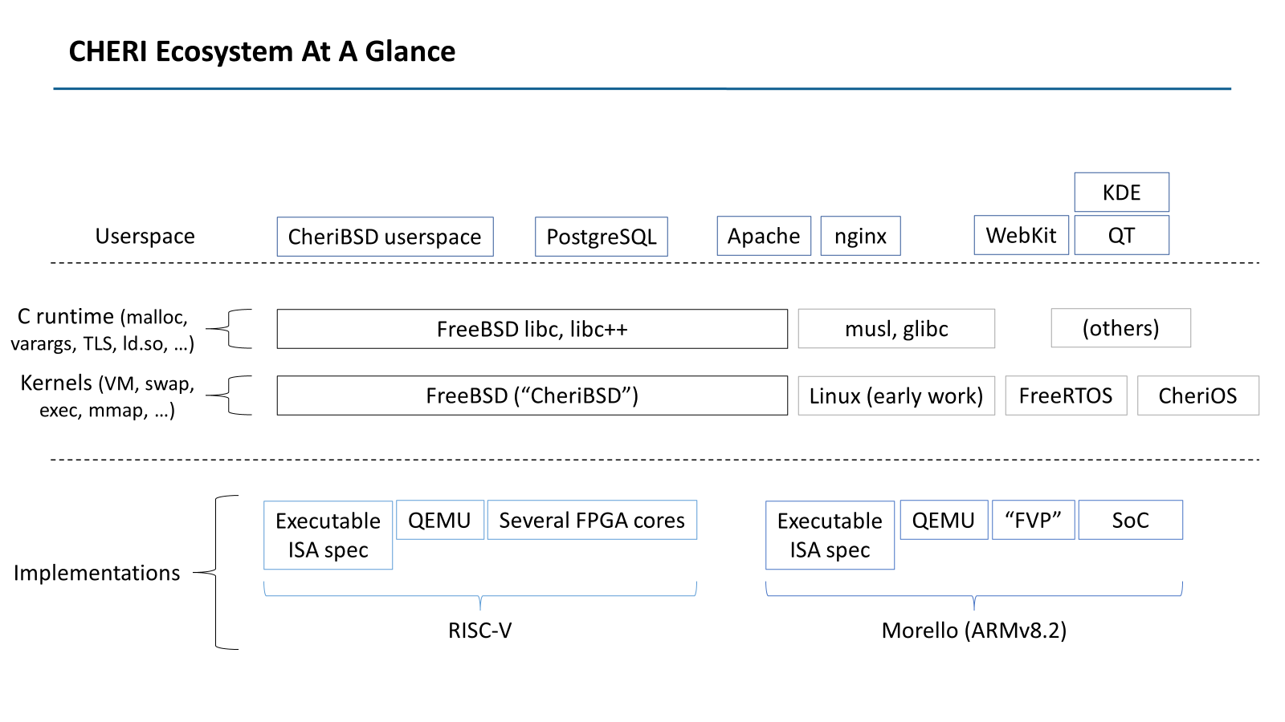
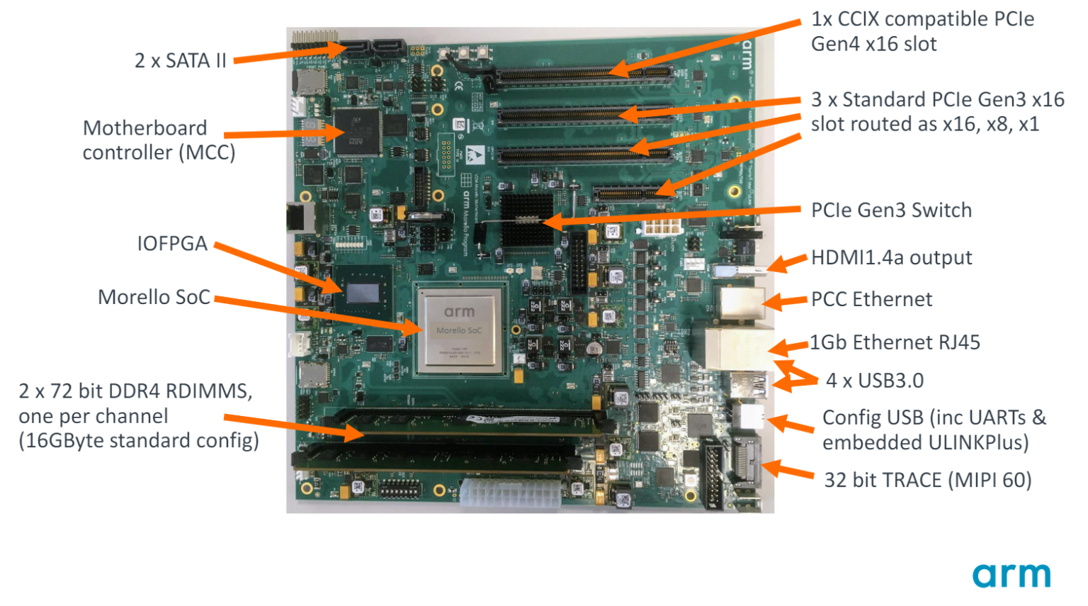
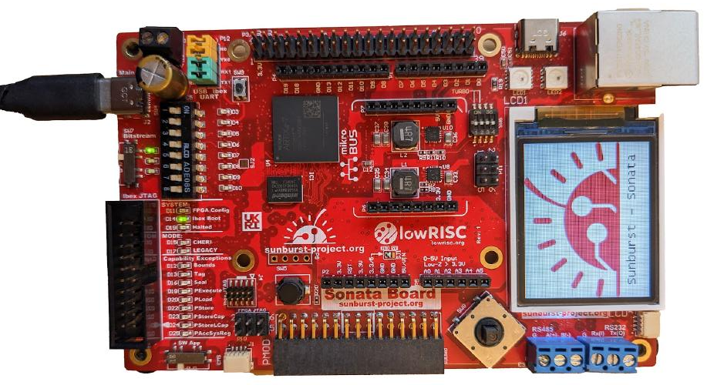
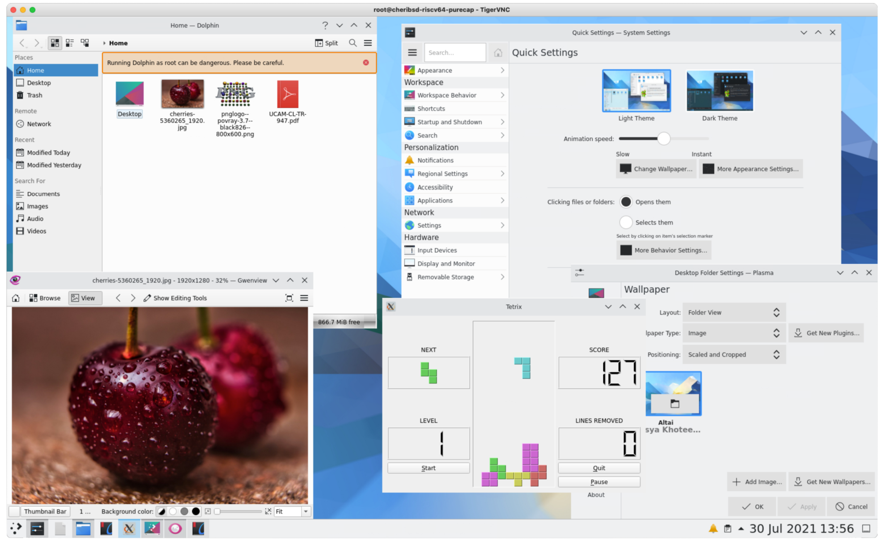

CHERI Is Escaping The Lab And Heading For The Village
“Morello” prototype SoC & board: 4-core, 2.5-GHz
CHERIoT (32-bit CHERI RISC-V)
lowRISC Sonata board​
SCI Semi ICENI
Assessing the Viability of an Open-Source CHERI Desktop Software Ecosystem
Notes:
CHERI looks to be escaping the laboratory and should be in commercially available microprocessors as soon as next year, with server, desktop, and phone CPUs to follow in the next few years.
Arm and partners (including Microsoft) are doing an industrial-scale science experiment, named Morello (it’s a kind of cherry): ARMv8.2 with CHERI with a modern CPU design, clocked at 2+GHz. Morello is (emphatically) not, but will hopefully influence, successors to ARMv9.
The University of Cambridge and its partners have all of KDE ported to Morello and fully open-source CHERIfied RISC-V, along with PostgreSQL, Apache, WebKit, and more than I can name. Chromium real soon.
In the other direction, CHERI also scales down to the embedded space, with CHERIoT building on 32-bit RISC-V, available open-source in FPGA and taping out this or next year.
All of that to say, if you continue to be systems programmers, it is looking increasingly likely that CHERI will be part of the world you live in.

Slide 58
Architectural Metadata for Memory Safety
Architectural metadata: an idea whose time has finally come?
New systems to better let the CPU understand programmer intent
  PAC: “sign” pointers to convey authenticity and intent
  MTE: “color” memory to convey information about object layout and lifetime
  CHERI: replace pointers with “capabilities”, unforgeable tokens of authority
Useful to debug and/or mitigate the cause of many long-standing classes of security vulnerabilities
PAC has been around, MTE shipped last year, CHERI very soon through next few years!
If you continue to be systems programmers, expect to see more and different kinds of metadata
Notes:
Backing up from CHERI, even if it flops, it is likely that architectural metadata is an idea whose time has finally come.

Slide 59
Design Matrix!
 | PAC | MTE |  | CHERI
Metadata Location | In-pointer | In-pointer + out of band (4) |  | In-pointer + out of band (1)
Pointer & address size | Native; ~40 bits | Native; ~60 bits |  | 2x Native; Native
Pointer Integrity | Yes, but cryptographic | No |  | Yes, deterministic
Adjacent overflow | No | Yes | O(n) and flat | Yes, O(1) and can nest
General spatial bounds |  | Stochastic
Heap obj. temporal safety | No | UAF, yes; UAR, stochastic |  | UAF safe; UAR via sweeping
Flow control | Some: context word | No |  | Some: sealing & others
Secrets? | Yes ☹ | Yes ☹ |  | No ☺
Hardware mods required | New instructions | New instructions, checks and traps, OOB colors, caches |  | Wider registers, new instructions, checks and traps, OOB tags, caches
Software modes required | Compiler (& recompile), small kernel changes | Heap allocator, compiler (& recompile), small kernel changes |  | Compiler (& recompile), kernel, libc, & small app changes

Slide 61
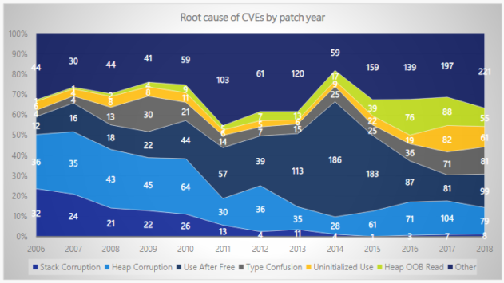
CVEs and High Severity Bugs from (Lack of) Memory Safety
Notes:
Sources: Matt Miller BlueHat 2019

Slide 62
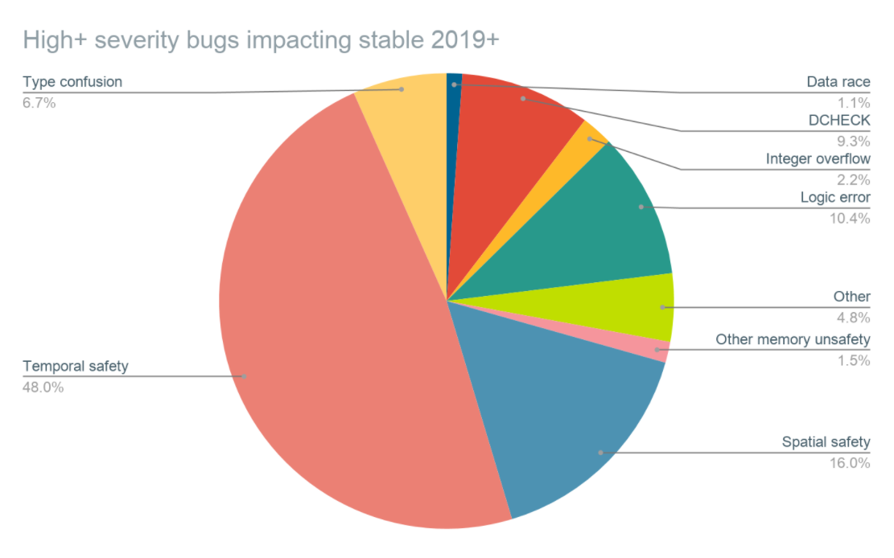
CVEs and High Severity Bugs from (Lack of) Memory Safety
Notes:
Sources: Google’s “Safe Use of C++” 2021.

Slide 63
CVEs and High Severity Bugs from (Lack of) Memory Safety
Amar et al. Security Analysis of CHERI ISA. (Blackhat 2021)
Notes:
So, if you take 70% of an increasingly bad time, it turns out to still be an increasingly bad time. Microsoft Security Response Center is handling more and more memory safety issues per year.

Slide 64
CHERI enforces protection semantics for pointers
Data
Code
Heap
Globals
Stack
Control flow
Integrity and provenance validity
Bounds
Monotonicity
Permissions
Integrity and provenance validity ensure that valid pointers are derived from other valid pointers via valid transformations; invalid pointers cannot be used
  Valid pointers, once removed, cannot be reintroduced solely unless rederived from other valid pointers
  E.g., Received network data cannot be interpreted as a code/data pointer – even previously leaked pointers
Bounds prevent pointers from being manipulated to access the wrong object
  Bounds can be minimized by software – e.g., stack allocator, heap allocator, linker
Monotonicity prevents pointer privilege escalation – e.g., broadening bounds
Permissions limit unintended use of pointers; e.g., W^X for pointers
These primitives not only allow us to implement strong spatial and temporal memory protection, but also higher-level policies such as scalable software compartmentalization

Slide 65
Misbehaving C Program, Now With CHERI but Without Narrowed Bounds?
0000000000001b00 <foo>:
addi a1, zero, 65
csb a1, 16(ca0)
csb a1, 32(ca0)
cret
0000000000001b10 <main>:
cincoffset csp, csp, -48
csc cra, 32(csp)
cmove ca0, csp
auipcc cra, 0
cjalr -28(cra)
mv a0, zero
clc cra, 32(csp)
cincoffset csp, csp, 48
cret
void foo(char *buf) {
buf[16] = 'A';
buf[32] = 'A';
}
int main(void) {
char pad[16], buf[16];
foo(buf);
return 0;
}
CHERI RISC-V, w/o csetbounds
Whoops! Forgot
to narrow bounds.
Stack as of entry to foo() |  | V
sp+32 | main’s saved %cra
sp+16 | pad[0] … [15] | 0
sp+0 | buf[0] … [15] | 0
gdb says:
0
1
Program received signal SIGPROT, CHERI protection violation
Capability tag fault caused by register cra
… in main ()
ca0
Notes:
What happens if we forget to narrow the stack capability? Then…
The stores now happen without trapping
The store over the saved return address clears the valid bit
The program still crashes, just later, when main goes to return.
When we reload the saved return address, it won’t be a valid capability.
When we try to jump to that, the processor will trap.
The thing I want you to take away from this is that CHERI closes the door on many of the “first-order” primitives available to attackers:
Buffer sizes can be enforced: a pointer cannot be used to write out of bounds!
Data can’t be confused with pointers. Can’t just overwrite a return or function pointer.

Slide 66
CHERI: A New Foundation for Software Security?
CHERI is…
12+ year project from the University of Cambridge’s Computer Laboratory
radical, “new computer” approach: change how pointers work
  A foundational shift akin to turning on virtual memory between P1 and P3; things will be different.
not so radical after all?
  CHERI composes well with modern microarchitectures
  Maybe C/C++ (and FFI) can be made safe(r)
Chisnall et al. Beyond the PDP-11: Architectural support for a memory-safe C abstract machine. (ASPLOS 2015)
Notes:
Of course, we, the CHERI project, are not the first to identify a 50-year-old problem. Lots of people have tried lots of things ranging from minor tinkering to vast, sweeping overhauls of everything. Unfortunately, nothing really seems to have moved us closer to “done” for commodity computers.
But, for all that, don’t get discouraged! I’m going to try to convince you that there’s hope, if we make a different kind of change.
Enter CHERI, a decade and counting project based at the University of Cambridge
On the one hand, CHERI is radical proposal that we change how pointers work, in both software and hardware. This is a shift to the von Neumann model of computing on the same scale as adding virtual memory (for what would become commodity platforms, this was around 1973; it’s OK if you don’t remember a time before).
On the other hand, I will try to convince you it’s not so radical after all.
I hope to show you that a computer with CHERI looks a lot like a computer without CHERI did, and that we might not have to throw away C/C++ and the enormous quantity of software (accumulated human effort) written in those languages to get to a better place.
Arm and its partners have engineered the “Morello” prototype SoC, a CHERIfied, quad-core, multi GHz extension of the Neoverse N1.

Slide 67
CHERI Summary
CHERI enriches CPUs to have tagged capabilities with architecturally-enforced invariants
  Solves many root causes of long-standing security vulnerabilities
  Promising compartmentalization designs
  If nothing else, a good candidate for the 410 book-report!
Looks quite real: FPGA RISC-V & Arm Morello SoC, LLVM, CheriBSD, Qt, KDE, …
If you want to know more, please do get in touch:
  http://www.cheri-cpu.org/ for (much) more reading material, Slack, e-mail lists, &c.
  CHERI-related 412 projects!
Play along at home, too; almost everything is FLOSS:
  https://github.com/CTSRD-CHERI/cheripedia/wiki/Getting-Started a how-to (from another former 410 TA!)
  https://github.com/ctsrd-cheri/cheribuild one-stop-shop build system
  https://github.com/CTSRD-CHERI/cheri-exercises hands-on introductory exercises

Slide 68
Book Report Fodder
CHERI:
Watson et al. Introduction to CHERI. (Tech report, 2019).
Joly et al. Security analysis of CHERI ISA. (2020).
Microsoft Security Response Center. What’s the smallest variety of CHERI? (2022)
Chisnall et al. Beyond the PDP-11: Architectural support for a memory-safe C abstract machine.
Davis et al. CheriABI: Enforcing Valid Pointer Provenance and Minimizing Pointer Privilege in the POSIX C Run-time Environment. (extended report).
Filardo et al. Cornucopia: Temporal Safety for CHERI Heaps.
Joannou et al. Efficient Tagged Memory.
Esswood. CheriOS: designing an untrusted single-address-space capability operating system utilising capability hardware and a minimal hypervisor.
Watson et al. Balancing Disruption and Deployability in the CHERI Instruction-Set Architecture (ISA).
Capabilities Limited. Assessing the Viability of an Open Source CHERI Desktop Software Ecosystem.
CHERI Instruction-Set Architecture (Version 9).
Henry M. Levy. Capability-Based Computer Systems.

Slide 69
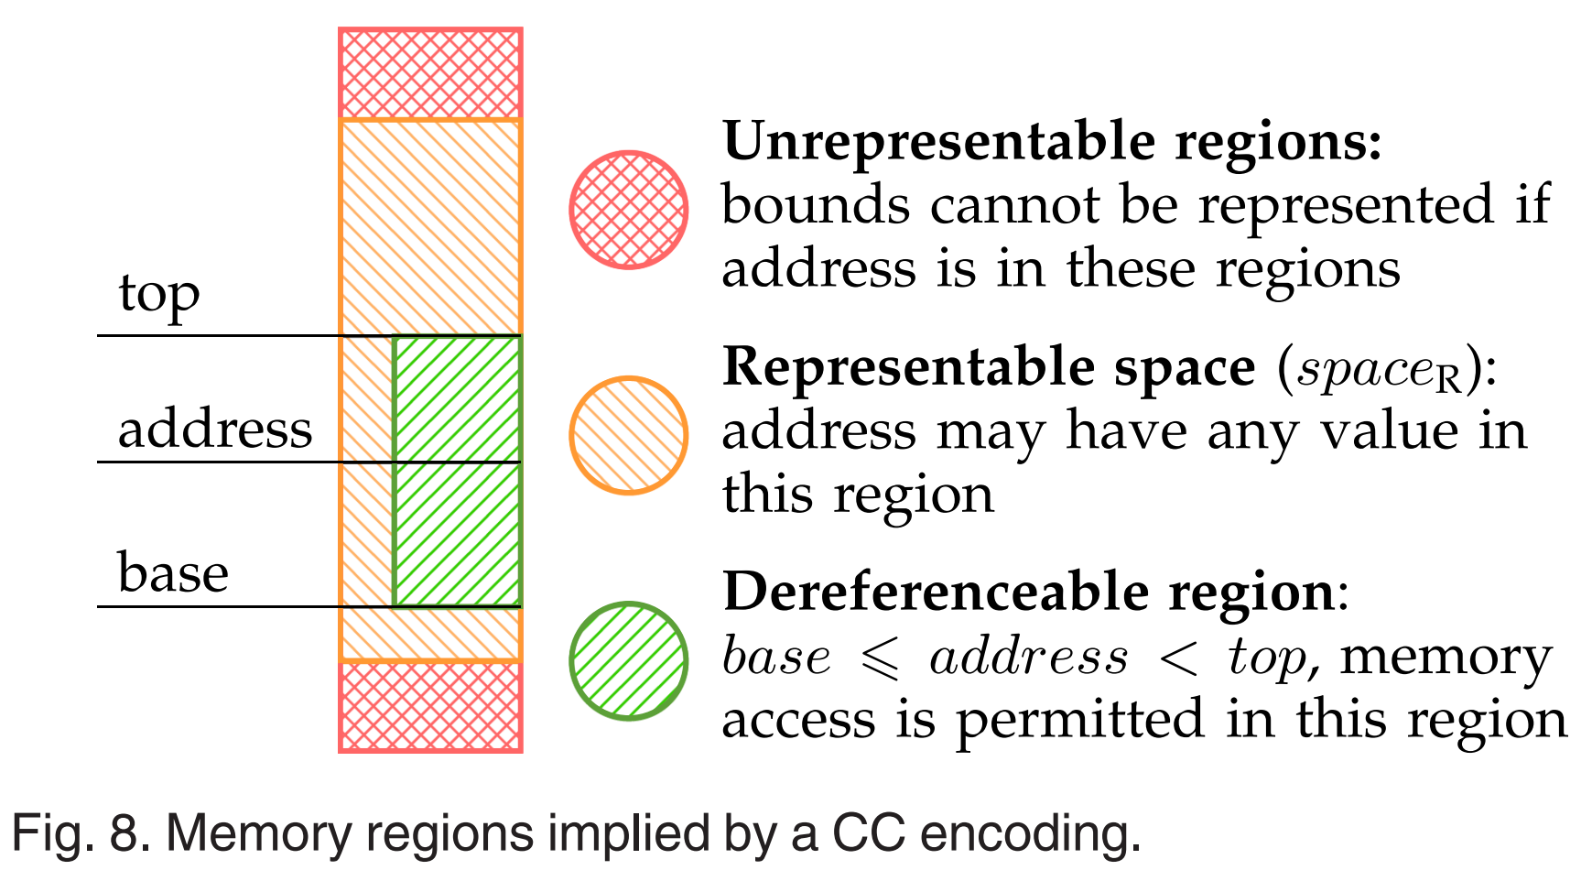
CHERI Concentrate Representability
Woodruff et al. CHERI Concentrate: Practical Compressed Capabilities. (2019)

Slide 70
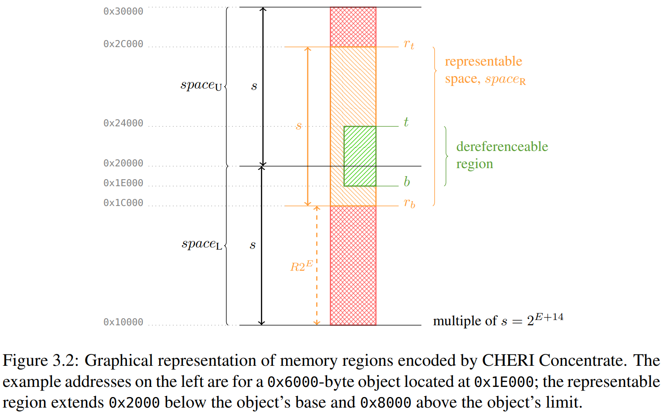
CHERI Concentrate Representability
CHERI Instruction-Set Architecture (Version 9).

Slide 71
CHERI Tags in Cores and Caches
Tags in data caches
CPU
L1D$
L2$
DRAM
⁞
Regs
⁞
PC
L1I$
Reserved RAM for tag table
⁞
Tag controller
Tag in register
Bigger registers hold caps
New tag controller, L2$ splits tags & data
Joannou et al. Efficient Tagged Memory. (ICCD 2017)
Notes:
One of the central design objectives of CHERI was that it couldn’t need a whole new everything. Importantly, it needed to be compatible with commodity memory (and busses and so on).
Peeking beneath the architectural covers, as it were, let’s look at a slightly more detailed, roughly 213-level, view of what happens in the memory hierarchy.
As said before, we augment the CPU core to hold capabilities in registers: so, roughly 2x the size plus tag bits.
Add tags to data cache lines; tags now move in tandem with data through the cache hierarchy.
L2$ splits lines, holding both data and tags, into separate channels, sends data directly to DRAM and tags to a new tag controller. This might be as simple as a bitmap, but prior work shows great gains from a small hierarchical caching scheme here.
The tag controller is backed by a carve-out of RAM, which is not accessible to software: software cannot manipulate tags except as part of a capability.

Slide 72
CheriABI: Spatially Safe UNIX Processes
Discussion: read() and capability bounds
read(fd, lower, sizeof(lower) + sizeof(upper))
RISC-V Baseline
CHERI-RISC-V
Write OK
lower=0x80922400 upper=0x80922410
Read 0x20 OK; lower[0]=0x10 upper[0]=0x20
Write OK
lower=0x3fffdfff28 upper=0x3fffdfff38
Bad read (Bad address); lower[0]=0x10 upper[0]=0x0
Kernel overwrite!
Kernel return –EFAULT;
Does not write OOB
Fault detected during copy-out
CheriABI system calls take capabilities, and
  voluntarily act with implied restricted authority!
Notes:
What happened when we asked the kernel to write out of bounds?
On the baseline architecture, the kernel had no way of knowing what our bounds were, so it took our word for the length of the structure.
With CHERI, the system call passed a capability to the kernel, and the kernel used that capability when writing to user memory, rather than using its own elevated authority.
[as it says]
In fact, we can see that the kernel only noticed the discrepancy between capability length and request length after it had started copying data to the user program. *nix-like kernels generally have well-defined points where they copy data in from or out to the user program; making these use capabilities is enough to catch these kinds of misbehaviors of userspace, and relatively little of the read() path needs to be altered from what was already there.

Slide 73





Sealed and Sealing Capabilities
RW
RW
RW
Sealing
Capability
Sealed Capability
(immutable, inert)
Unsealing
Capability
Seal and Unseal types must match
RX
RX
RX
PCC
RW
RW
RW
IDC
RX, RW capabilities
under same seal
Unseal and jump
w/ equal-seal pair
Notes:
One answer, it turns out, is to enrich CHERI with additional kinds of capabilities. We’ll consider two, here: sealed capabilities as well as sealing (and unsealing) capabilities. At last, we’ll come to talk about some of that other metadata inside the capability structure I alluded to way back in the intro.
A CHERI capability can be combined with a sealing capability to produce a sealed capability. These are immutable (try, and you’ll clear the tag) and inert, in that they do not authorize other operations.
You can only pass around, or drop, a sealed capability until it is combined with an unsealing capability to reveal the original input, which can now be used as it was.
The sealing and unsealing capabilities must match: if they don’t, unsealing fails.
These kinds of capabilities are useful to represent resources that we want software to be able to reference but not directly use without executing code that has access to the appropriate unsealer.
Expanding on that mechanism, we can also do something interesting if we construct two sealed capabilities with the same seal.
We can invoke the sealed pair, handing them both to an instruction, which will unseal and jump. You can think of this in an OOP way: the sealed capabilities represent an object’s data and a method that we want to call on that object. Or we could use this to exit a sandbox in a very continuation-passing style: the data is the outer context’s continuation’s data, and the method is the continuation’s code.

Slide 74



Advanced Topics
Sealed and Sentry Capabilities
Sealing and Explicit Unsealing:
  Sealed capabilities’ authority cannot be exercised until unsealed
  Seals come in multiple types; must have appropriate type-capability to seal and/or unseal
  Intended uses include RTTI checks and for inter-compartment references
RW
RW
RW
Can unseal by CInvoke: sealed code and data caps of equal type; code becomes PCC, data IDC:
X
RW
RW
IDC
RW
PCC
X
CHERI also defines some flavors of “sentry” (“sealed entry”) capabilities which unseal in jumps:
  Single capability, becomes PCC when unsealed – useful for function entry, return addresses
  Pointer to PCC, becomes IDC when unsealed, PCC loaded from target – “pointer to intrusive vtable”
  Pointer to pair, PCC and IDC loaded – “proxy for method and instance”

Slide 75
CheriBSD Code Changes
Area | Files total | Files modified | % files | LoC total | LoC changed | % LoC
Kernel | 11,861 | 896 | 7.6 | 6,095k | 6,961 | 0.18
Core | 7,867 | 705 | 9.0 | 3,195k | 5,787 | 0.18
Drivers | 3,994 | 191 | 4.8 | 2,900k | 1,174 | 0.04
Userspace | 16,968 | 649 | 3.8 | 5,393k | 2,149 | 0.04
Runtimes (excl. libc++) | 1,493 | 233 | 15.6 | 207k | 989 | 0.48
libc++ | 227 | 17 | 7.5 | 114k | 133 | 0.12
Programs and libraries | 15,475 | 416 | 2.7 | 5,186k | 1,160 | 0.02
Notes:
Numbers from cloc counting modified files and lines for identifiable C, C++, and assembly files
Kernel includes changes to be a hybrid program and most changes to be a pure-capability program
  Also includes most of support for CHERI-MIPS, CHERI-RISC-V, Morello
  Count includes partial support for 32 and 64-bit FreeBSD and Linux binaries.
  67 files and 25k LoC added to core in addition to modifications
  Most generated code excluded, some existing code could likely be generated

Slide 76
Clang/LLVM/LLD Code Changes
Area | Files total | Files modified | % Files | LoC total | LoC changed | % LoC
LLVM | 4220 | 44 | 1.0 | 1656k | 217 | 0.013
Clang* | 1593 | 30 | 1.9 | 911k | 190 | 0.021
LLD | 249 | 5 | 2.0 | 67.8k | 30 | 0.044
Total | 6062 | 79 | 1.3 | 2365k | 432 | 0.018
Notes:
Changes predominantly (u)intptr_t vs size_t/ptrdiff_t confusion, static_asserts about struct sizes/layouts no longer true with 128-bit pointers, and a few instances of using uint64_t for pointers
Able to compile and link a pure-capability C hello world natively on CHERI-RISC-V
(*) One outstanding known issue in the frontend prevents compiling a C++ hello world
  Implementation and header files in question only total an additional 193 lines, or 0.021%, as a worst-case upper bound
Just over half the Clang changes (99 LoC) are for its bytecode-based C++ constexpr interpreter

Slide 77
WebKit - JSC Code Changes
Area | Files total | Files modified | % Files | LoC total | LoC changed | % LoC
JSC-C | 3368 | 148 | 4.4 | 550k | 2217 | 0.40
JSC-JIT | 3368 | 339 | 10.1 | 550k | 7581 | 1.38
Notes:
JSC-C is a port of the C-language JavaScriptCore interpreter backend
JSC-JIT includes support for a meta-assembly language interpreter and JIT compiler
Runs SunSpider JavaScript benchmarks to completion
Language runtimes represent worst-case in compatibility for CHERI
  Porting assembly interpreter and JIT compiler requires targeting new encodings
Changes reported here did not target diff minimization
  Prioritized debugging and multiple configurations (including integer offsets into bounded JS heap) for performance and security evaluation
  Some changes may not be required with modern CHERI compiler

Slide 78
Heap Allocator & Spatial Safety (Montonicity)
Shared Heap
Capability (allocator-owned)
Allocator (TCB)
Client (untrusted)
Capability (allocated object)
Derive for client
Capability (subobject)
Narrow bounds
Notes:
Allocator is part of TCB: enforces (and so, can violate) spatial memory safety. Holds elevated access to the whole heap, as typical of GC/RTS.
1) When deriving capabilities in response to client requests, allocator sets spatial bounds (again, at construction). No action by the client will let it use this capability to access beyond those constructed bounds.
2) When client returns capability to free(), bounds can only have been monotonically changed: must be a subset of the bounds given out, and so are a kind of architectural handle on the original allocation.
Existing CHERI-fied malloc implementations are imperfectly defensive and especially open to temporal attacks on their own metadata and/or allow clients to violate C’s model by creating temporal aliases.

Slide 79
Advanced Topics
CheriABI (2/2)
crt/rtld
malloc()
code
C
C
RWX
to all user-space
RW
RW
RW
RW
User-space Addresses
RW
RW
R
RX
.text
.rodata
.data
g_foo
heap
stack
exec()
mmap()
Notes:
So, where does a process get its very first capability?
User capabilities originate from the kernel, which holds a capability to all of userspace with full permissions.
On exec(), the kernel constructs subset capabilities for the program sections (text, rodata, data and bss) and the initial stack.
It uses the .text capability to jump to the entrypoint (so that capability ends up in the program counter) and installs the initial stack capability in the stack capability register; .rodata and .data put somewhere agreed upon.
(This might sound shockingly familiar if you think back to your Pebbles’ exec() call; your kernels, too, had to install primordial PCs and SPs!)
As the program runs, it can refine its own capabilities, as we saw it do with an on-stack array allocation.
If the program calls malloc(), malloc() calls mmap() and retrieves a capability to the new pages…
and then derives subset capabilities for each allocation.
We can even have the startup code or program loader narrow the capabilities used to access globals inside .data or .bss, so that the program can’t access out of bounds there, either.
(The details here are shockingly involved, but I think it’s important to note that this isn’t a hole in CHERI’s defenses.)

Slide 80

CheriABI
CHERI Memory Capabilities Meet *NIX
Notes:
With that small example and basic architecture in mind, let’s scale up to an entire operating system!

Slide 81
Compiling C to CHERI
Language-level memory safety
CHERI capabilities used for both
  Language-level pointers visible in source program
  Implementation pointers implicit in source
Compiler generates code to
  bound address-taken stack allocs & sub-objects
  build caps for vararg arrays
Loader builds capabilities to globals, PLT, GOT
  Derived from kernel-provided roots
  Bounds applied during reloc processing
Small changes to C semantics!
  intptr_t, vaddr_t
  memmove() preserves tags
  Pointers have single provenance
  Integer ↔ pointer casts require some care
Pointers to heap
allocations
Pointers to global variables
Function pointers
Pointers to memory mappings
Pointers to stack allocations
Pointers to TLS variables
Pointers to sub-objects
GOT pointers
Vararg array pointers
PLT entry pointers
Return addresses
C++ v-table pointers
ELF aux arg pointers
Stack pointers
Sub-language memory safety
See CHERI C/C++ Programming Guide.
Notes:
We can take this idea to its logical conclusion: let’s use capabilities for everything, or, at least, all pointers in a process.
That means both the pointers you see and think about in the language as well as the ones you don’t see or think (much) about below the language.
So, the compiler, loader, and even kernel also must be active participants in the implementation.
The C language semantics do have to change a little bit; please do see our programming guide for details.

Slide 82
CheriABI: Spatially Safe *NIX Processes
Capabilities now implement all pointers in a process
More faithfully captures program intent as “objects with links between them”
Davis et al. CheriABI: Enforcing Valid Pointer Provenance and Minimizing Pointer Privilege in the POSIX C Run-time Environment. (ASPLOS 2019)
Notes:
And if we do use capabilities to represent every pointer in a process, what we get is a capability graph between different objects, with the thread register files forming the roots.
We call this environment “CheriABI”.

Slide 83
Morello: An experimental ARMv8 with CHERI
“Morello” prototype SoC & board: 4-core, 2.5-GHz Armv8.2-A w/ CHERI extensions
Notes:
CHERI looks to be escaping the laboratory and may be in commercially available chips within the decade. Arm and partners (including Microsoft) are doing an industrial-scale science experiment, named Morello (it’s a kind of cherry): ARMv8.2 with CHERI with a modern CPU design, clocked at 2+GHz. Morello is (emphatically) not, but will hopefully influence, successors to ARMv9.
If you continue to be systems programmers, it is looking increasingly likely that CHERI will be part of the world you live in.

Slide 84
CHERI Ecosystem At A Glance
KDE
Userspace
CheriBSD userspace
PostgreSQL
Apache
nginx
WebKit
QT
C runtime (malloc,
varargs, TLS, ld.so, …)
FreeBSD libc, libc++
musl, glibc
(others)
Kernels (VM, swap,
exec, mmap, …)
FreeBSD (“CheriBSD”)
Linux (early work)
FreeRTOS
CheriOS
Executable ISA spec
QEMU
Several FPGA cores
Executable ISA spec
QEMU
“FVP”
SoC
Implementations
RISC-V
Morello (ARMv8.2)
Notes:
CHERI has two primary architectural incarnations these days: as Morello (SoC) and atop RISC-V (FPGA). Both also have executable ISA specifications and emulators (QEMU and Arm’s Morello “Fixed Virtual Platform”).
Atop this hardware, most of our work takes place with a modified FreeBSD (“CheriBSD”). The kernel and C runtime components have been made CHERI-aware.
The whole software stack is built primarily in cross-compilation using a capability-aware branch of LLVM (so clang and lld).
We have, similarly, educated gdb for native and cross-debug.
Continuing upwards, we have the FreeBSD userspace programs; servers like Apache, nginx, and PostgreSQL; and client software like WebKit, the QT library, and almost all of KDE ported.
There’s a whole lecture’s worth of material about porting C/C++ programs to CHERI, but generally, higher in the stack means significantly less work.

Slide 85
KDE on CHERI-RISC-V over VNC
Notes:
Everybody likes screenshots, right? So, here’s KDE, Plasma and all, running fully CHERIfied on CheriBSD on RISC-V, in qemu over VNC. This all runs on Morello, too, as a “real computer” with GPU and everything.
Image courtesy Capabilities Limited.

Slide 86
Cornucopia: CHERI Heap Temporal Safety
Quarantine & Batched Revocation
Kernel offers revocation service to user programs
  Exposes revocation bitmap, encodes live/free state of memory.
On free, allocator…
  holds address space in quarantine
  marks corresponding bits of object
When quarantine fills, allocator invokes revoker service
  Deletes all capabilities whose targets have marked revocation bits
After revocation, safe to reuse address space
  Allocator clears shadow, enqueues address space to free lists
Address Space
Kernel
Shadow
Stack
Heap
Globals
Thread registers
Filardo et al. Cornucopia: Temporal Safety for CHERI Heaps. (Oakland 2020)
Notes:
In more detail, on free, the allocator marks the bitmap bits of the freed object and holds the address space in quarantine, to amortize the cost of sweeping revocation.
When quarantine fills, allocator calls revoker
Which deletes capabilities to addresses with marked shadows
After revocation finishes, it is safe to reuse address space
The allocator has to clear the shadow before reissuing memory, lest the revoker strike again

Slide 87
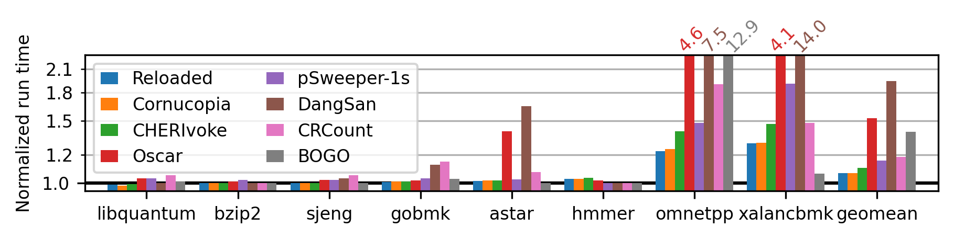
Sweeping Revocation Performance
Isn’t checking every capability in the address space horrifically expensive?
“Cornucopia Reloaded”, SPEC CPU2006 INT, revoke target <33% heap in quarantine, wall-clock overheads on Morello: <10% geomean, <30% worst case!
Key insight: CHERI validity bits precisely identify all potential references to memory.
  Don’t have to guess, and we are justified in erasing pointers to quarantine.
Cornucopia Reloaded: Load Barriers for CHERI Heap Temporal Safety (2024)
Notes:
Isn’t that horrifically expensive?
Not as much as you might think, though there’s still work to be done. Across SPEC CPU2006 benchmarks, we see a geomean of under 7% and a worst case of under 30% wall-clock overheads.
The key insight here is that CHERI validity bits precisely identify potential references to memory, so we don’t have to look at each word and guess. Moreover, we’re justified in erasing pointers – changing memory – because we know that it’s a capability.

Slide 88
Cornucopia: Heap Temporal Safety Atop CHERI
Address Space Quarantine, Revocation
Address Space
Focused on heap temporal safety
  More complex lifetimes than stack objects, resists static approaches
Heap pointers end up in globals, stacks, registers, kernel heap, …
Risk: retain references to free() object, overlap new allocation
Eliminate “use-after-reallocation” by revoking dead references
  UAF still possible, but accesses old object
Hold address space in quarantine to amortize sweep cost
  Quarantine state held out of band
“Dual” of garbage collection: (lazily) enforce free()
Kernel
Stack
Heap
Globals
Thread registers
Notes:
We’ve been considering temporal safety of heap allocation, since heap objects have a wider variety of, and more complicated, life cycles than stack objects. That’s not to say that stack temporal safety is trivial, just momentarily out of scope.
As part of those complex life cycles, pointers into the heap tend to spread: into other globals, onto the stack, and even into the kernel heap (for example, as part of asynchronous I/O).
That means that there’s a risk that the application inadvertently retains a reference to a free object, which then comes to overlap a new allocation.
This is, of course, undefined behavior in C, but that doesn’t mean it doesn’t happen.
This opens the possibility of “use after reallocation” wherein a stale reference is dereferenced and accesses or corrupts the new object, often either exposing data or corrupting data structures.
(“Use after free”, before addresses are repurposed, is typically less of a concern.)
The basic approach we’re considering is to revoke these stale references, and be sure that we have eliminated them all, before reusing address space.
Revocation is global and involves testing every capability in the process, so we quarantine

Slide 89
Sweeping Revocation Implementation
4K page being swept
“Is this quarantined?” bitmap
…
…
Cache lines w/o tags: skip
Load cap, get base address
Load bitmap bit, CAS NULL if set
Notes:
Glossing over a whole lot of details, the way the sweep works involves two key pieces:
We need some way of answering “is this address part of quarantine”. The allocator marks quarantined regions of the address space in a bitmap.
The kernel can look at every page in the address space.
For each capability on each page, probe the shadow bitmap based on the trustworthy capability base value. (Monotonicity ensures that base must be in bounds of original allocation.)
4) Have added CLoadTags instruction to coherently fetch CHERI tags w/o fetching data; lets us skip entire lines w/o capabilities.
We, in fact, have some tricks up our sleeve to avoid looking at pages that don’t have capabilities on them, too, like you’d find in file mappings or under big numeric arrays.
Of note, we are not behaving like a tracing GC here. We’re not following the pointer graph, we’re just looking at every pointer, more or less in order! This predicts wonderfully and really just leaves the random probes of the bitmap, which is small(ish).

Slide 90

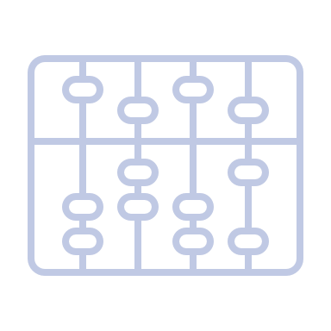

Architectural Acceleration for Revocation
CHERI Tags identify capabilities
  Don’t have to guess; revoker justified in erasing!
Capability-Dirty PTE Flags
  Set by PTW; skip sweep of pages w/o capabilities
Capability-Load Trap PTE Flags
  Cause CPU to trap; revoker scans (WIP)
Filardo et al. Cornucopia: Temporal Safety for CHERI Heaps. (Oakland 2020)
Notes:
This turns out to be feasible for CHERI because it is a capability architecture. We don’t have to guess whether words are pointers to objects or just suspicious numbers, and since we know with certainty, we are justified in erasing capabilities.
Beyond merely being possible, it turns out we can add just a little bit of architecture to speed things up significantly: we can have the CPU assist us in tracking which pages have capabilities on them (so we don’t need to sweep the ones that don’t), and we can avoid stopping the world by arranging for the CPU to trap when it tries to load a capability through a page we haven’t yet scanned.

Slide 91
Cornucopia Architecture
Per-Page “Capability-Dirty” Tracking
Cap-dirtyable
Cap-clean
Cap-dirty
Capability store to page; TLB AMO
Initial mapping, stores permitted
No caps found
on this alias
No caps found
on any alias
Capability store to page; trap
Notes:
OK, but how do we know which pages to sweep? Kernel tracks bits of AS that are forbidden to hold capabilities, but within permissive regions, many pages still do not hold capabilities. The revoker should ignore pages that are known to contain no capabilities.
We extend CHERI’s page table bits to help track the spread of capabilities, adding a notion of “capdirty”, a low-overhead “card-marking” store barrier scheme (though without generational considerations).
PTEs dictate the behavior of cap stores: forbid, permit, or permit subject to automatic, atomic marking.

Slide 92
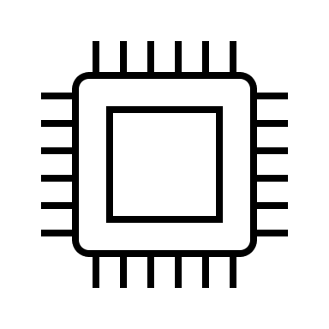
Cornucopia Architecture
Per-Page Capability Load Generations
TTBR
PD
PT
Phys mem
1
No trap: tag set, gen =
0
0
0
No trap: tag clear
1
1-bit generation counter in core
Trap: tag set, gen ≠
… and in each PTE
Loads trap if (loaded CHERI tag set) and (core gen ≠ source page PTE gen)
Notes:
First Cornucopia design, published at IEEE S&P 2020, demonstrated viability but suffered from large pause times. As we want to sweep responsively as the application accesses memory (as well as completely, to allow reuse of memory), we have subsequently introduced an architectural notion of capability load generations: a per-PTE and per-core bit that must match on capability loads.
Data dependence means independent instructions after load may not retire until CHERI tag value is available to be checked. PTE generation value available as part of the translation.

Slide 93
Cornucopia Architecture
Revoking With Capability Load Generations
TTBR
PD
PT
Phys mem
1
1
0
1
0
1
0
1
0
1
1
1
0
Background scan visits all pages w/ caps, updates PTE generation
Revocation begins by stepping global load generation on all cores
As loads cause traps, sweep per page and update PTE generation
Notes:
Steady state is all generation bits equal
Revocation begins by incrementing the in-core generation. Now all capabilities is considered untested.
Sweep on pages as traps arrive, mark them as up to date.
Visit pages in background as well (currently done with a dedicated thread, so takes advantage of SMP systems w/ idle core)
4) Eventually, back in the steady state with all generations equal.
(Optimization: pages known to not contain capabilities are not brought up to date, but generation bits can’t matter)

Slide 94

Research: Colocation: Multiple Processes In One Address Space!
MMU-based isolation & selective sharing
Programs in separate address spaces
IPC by context switch
  Data copy by kernel (write/read on pipe)
    Both time and space costs!
  TLB switching also costs!
    Flush (time, power) or ASIDs (area, power)
Selectively shared pages
  Pointers to shared memory: fine
  Pointers in shared memory: … carefully
  Pointers from shared memory: WTF‽
Process 1
‽
Process 2
Notes:
Traditionally, processes live in different address spaces, and we use the MMU to isolate them.
If we want to do IPC, we context switch between the two…
And probably have the kernel copy some data for us.
This incurs TLB switching costs, in time, power, and/or silicon area.
We could also establish shared memory pages between the two address spaces, but there’s something funny here.
Pointers to the shared region are fine…
Pointers in the shared region are dubious, but can work if we’re careful…
But pointers from the shared region are probably nonsense.

Slide 95
Research: Colocation: Multiple Processes In One Address Space
Colocated Processes
  Many programs in one address space
  Isolation maintained with CHERI
IPC by function call (eliding some details)
  Can copy on call through “trusted switcher”
Really fast sharing: pass capability across IPC
  No misinterpretation risk from shared pointers
Process 1
Process 2
Notes:
CHERI lets us tear down the MMU-based walls between processes, so that we can run many processes in a single address space!
Isolation is maintained by the capability system: you can’t access what you can’t point at with a capability.
In this model we can do IPC through function calls, and, if we want copy semantics, we can use a trusted switcher that does that copying before completing the call. This is kernel-bypass IPC, with user threads directly crossing the traditional process boundary!
We get really fast sharing in this model, if we just pass a capability across that IPC layer.
And there’s no risk of mis-understanding an address in the shared region; shared capabilities are just… capabilities.

Slide 96
Performance Overhead?
Clearly some costs to the story.
Processor pipeline complexity, new cache “stuff”
  Still RISC; not X86 levels of complexity.
Space overheads: tag memory overheads (1/128th of DRAM space)
  You probably won’t notice the 1% change
Pointers double in size! Do we need all computers to have 2x as much DRAM??
  Data still just data! Cute cat videos still mostly just (adorable) bytes.
  Workload dependent. May be able to relax the truly expensive, pointer-heavy cases in interesting ways.
Fit half as many pointers in each cache line?! Double cache sizes? Line sizes? Bus frequencies?
  Not double, but certainly increase some thing(s) for workloads that need it.

Slide 97
Performance Overhead Measurements
As of ASPLOS’19, on CHERI-MIPS CPU in FPGA:
  0 - ~10% cycle overheads (= wall clock, here) in most cases
  Many L2 cache misses for pointer-heavy workloads from increased pointer size
Detailed report on Morello performance also available; ample nuance in big, prototype chip!
  “1.8% to 3.0% is our current best estimate of the [geomean] overhead … for a future optimized design”

Slide 98
CHERI Source Compatibility
Codebase kind | LoC Changes for CHERI
CheriBSD Kernel | 0.2%
Low-level runtime libraries | < 0.5%
JSC JIT | 1-2%
QT, KDE libraries | < 0.1%
CLI applications, libraries | ≈ 0.02%
QT, KDE applications | < 0.05%
DSbD Consortium Update. (2021/05)
Capabilities Limited. Assessing the Viability of an Open Source CHERI Desktop Software Ecosystem. (2021)
Notes:
There’s a whole lecture’s worth of material about porting C/C++ programs to CHERI, but generally, higher in the stack means significantly less work.
By design, CHERI is also broadly compatible with modern C-based software stacks, so most of its obligations are felt at lower levels of the software stack.
We can quantify this by noting that the impact, measured in source LoC changes, diminishes as we move away from support and runtime layers, with many KDE applications requiring no modifications for CHERI at all once QT and libraries had been adapted.

Slide 99
CHERIoT: Scaling CHERI Down to 32-bit Microcontrollers
CHERI scales down to microprocessor environments
32-bit addresses, so 64-bit capabilities
Designed for compartmentalized software: mutually distrusting components, secure communications
  RTOS more “microkernel” than “kernel”, only essentially trusted component after boot is ~400 instructions.
Takes advantage of small memories:
  Special permissions for stack capabilities, stack zeroed on cross-compartment call
  Heap temporal safety baked into the architecture
Fully open-source research project originally from Microsoft (now https://www.cheriot.org)
  Formal spec, compiler, emulator, Verilog implementation, RTOS, compartmentalized JS interpreter, …
  Tape out perhaps as early as next year(!)

Slide 100

Heap Allocator Use Case
Capability color
Shared Heap
Capability (allocator-owned)
Memory granule color
Allocator (TCB)
Recolor-on-free to close UAF window
Client (untrusted)
CHERI makes same-color neighbors OK
Capability (freed object)
Capability (allocated object)
Capability (allocated object)
Notes:
MTE augments each pointer and memory granule with a “color”. In CHERI+MTE, color bits are part of the capability metadata, and so protected against corruption.
On allocation, allocator derives bounded, colored capability to heap memory and grants this to the client.
The distinguished “rainbow” color value is allowed to derive capabilities of any color and change the color of memory.
Other colors can only produce the same color progeny and cannot change memory’s color.
The client is then free to use the derived capability, and eventually frees it.
The allocator uses its elevated authority to recolor memory, preventing the client’s valid capability from reaching memory. (Can zero memory itself with little/no additional cost at the same time.)
Recolor-on-free closes UAF window, which gives a better debugging story, and enables secure in-band metadata, simplifying allocator design. (More on that in a moment.)
CHERI handles the spatial safety concerns, so adjacent heap objects can have the same color without loss of security.
Re-allocation proceeds as last time, with the allocator constructing a new capability of the right color for the client. (Any in-band metadata cleared before return.)
Clients cannot change the color of their capabilities, nor can they recolor memory.
-----
Mismatching loads trap; data dependence may delay retirement of subsequent independent instructions, but no other costs.
Mismatching stores can fizzle: can retire immediately and will be dropped from the store buffer rather than updating in L1. Some complexity around store-to-load forwarding (wait, don’t trap, if colors mismatch?), but should hide latency of fetch for color comparison.
A purpose-built atomic compare-and-decrement-color instruction catches would-be double-frees and handles concurrent interaction with the revocation.
Even 1-bit “scaled down” MTE has useful security properties (closes UAF window) and simplifies software design (allows in-band metadata) but loses performance win of delayed revocation

Slide 101
Future work: CHERI+MTE Heap Temporal Safety
Free
revoke
Quarantined
reuse
malloc
Recolour
Allocated
last colour
free
Notes:
Putting everything together, CHERI and memory colouring let us give out spatially-bounded pointers to heap objects at particular colours.
When those objects are freed, we can recolour their backing memory, invalidating pointers to the freed object.
If we have not exhausted the colour space, memory can be queued for reuse immediately!
When we have exhausted the colour space for a given piece of memory, it is instead unmapped, if possible, and the address space held in quarantine.
Only when we are close to exhausting address space or when mapped memory is sufficiently fragmented must we run the revoker, which then makes address space safe for reuse.
Therefore, address space enters quarantine at a significantly reduced rate: 1/(ncolor-1) of the rate without MTE. A 4-bit MTE scheme lets us accumulate quarantine at a 15th the pace, and so with the same quarantine size, we need to revoke a 15th as often, or we could have a 15th the quarantine and revoke at the current pace, or some other tradeoff.

Slide 102
Safe Languages?
C/C++ on old computers
  Spatial and temporal errors lead to arbitrary code execution
C/C++ on new computers
  Spatial errors fail-stop (and maybe heap temporal errors, too!)
Ada / Java / C# / TypeScript / ML / Haskell / Rust / …
  Array index errors throw exceptions; other spatial errors impossible*
  Temporal errors impossible*
Notes:
Why might people think there’s competition between the two efforts? Let’s look in a little more detail.

Slide 103
Rewrite Everything to be Safe?
There’s a lot of C, some of it very expensive to have made, and some of it very fast.
TCB code is intrinsically unsafe (sit below safe language abstraction)
  Memory managers, garbage collector, context switcher, …
Different safe language runtimes likely view each other as unsafe!
Rewrite parts of programs?

Slide 104
CHERI + (Unsafe) Rust
Recently, Rust community has been fretting about semantics of unsafe Rust.
  Compiler transformations threatening correctness
Recent proposal to use CHERI-like “strict provenance” semantics!
  No integer-to-pointer casts, trivially “NPVI” semantics
  Distinguish usize from uaddr from uptr?
  Integers must be recombined with pointers: address from integer but provenance from pointer
Unsafe strict provenance Rust code should be less unsafe on CHERI!
Aria Beingessner. Rust's Unsafe Pointer Types Need An Overhaul. (2022)
Tracking Issue for strict_provenance on GitHub
Notes:
I’d just like to give a shout out to the Rust community where, for not entirely unrelated reasons, there is already a bit of a move towards a very CHERI-compatible story.

